Slide 1
CSN 102: Data Structures
Sorting Techniques: Bubble Sort, Insertion Sort, Selection Sort, Quick Sort, Merge Sort, Heap Sort, Bucket Sort

Slide 2
Bubble Sort
Sort list of n elements
In each iteration, find the maximum elements in remaining unsorted list and move it to end. Do this in max m-1 iteration by comparing successive elements where m is the number of elements remaining in unsorted list at any given stage.
bubbleSort(int a[], int n) {
for (int i=0; i<n-1; i++)
for (int j=1; j<n-i; j++) {
if (a[j-1]>a[j])
swap(a[j-1], a[j]);
}
}

Slide 3
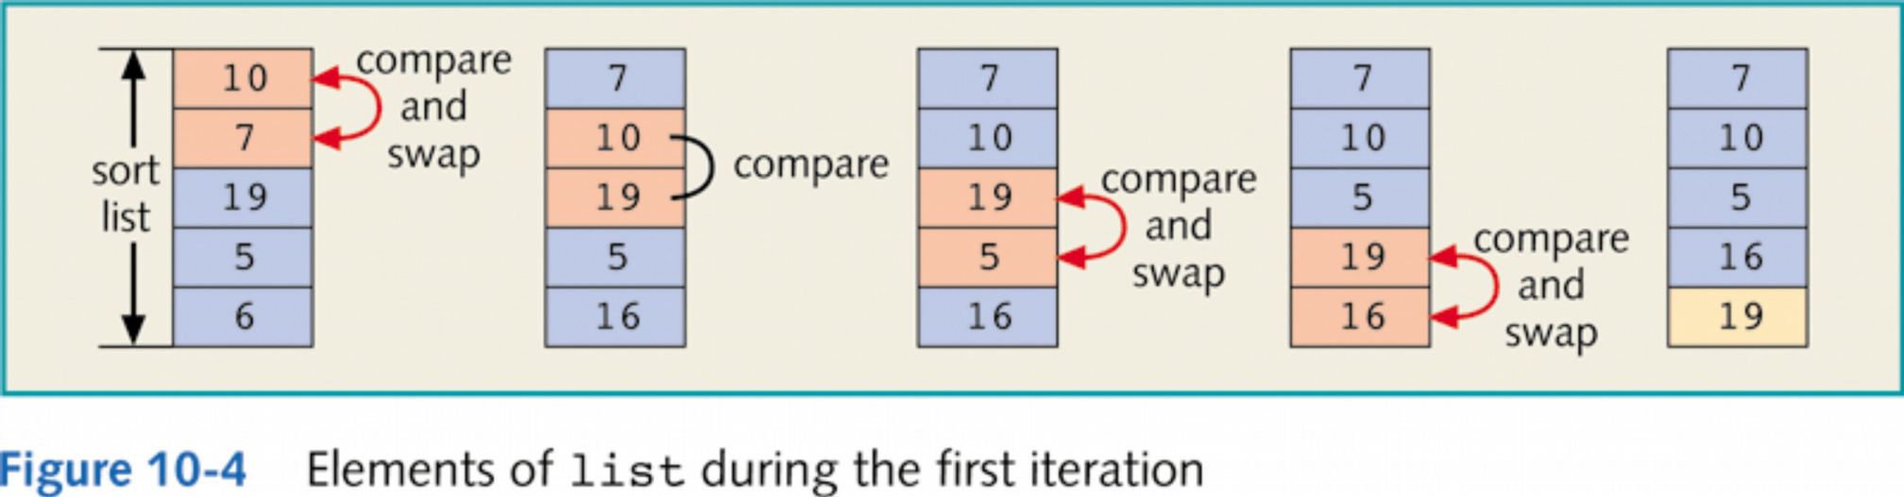
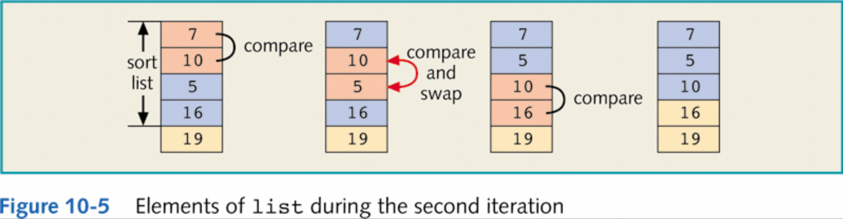
Bubble Sort: Example

Slide 4
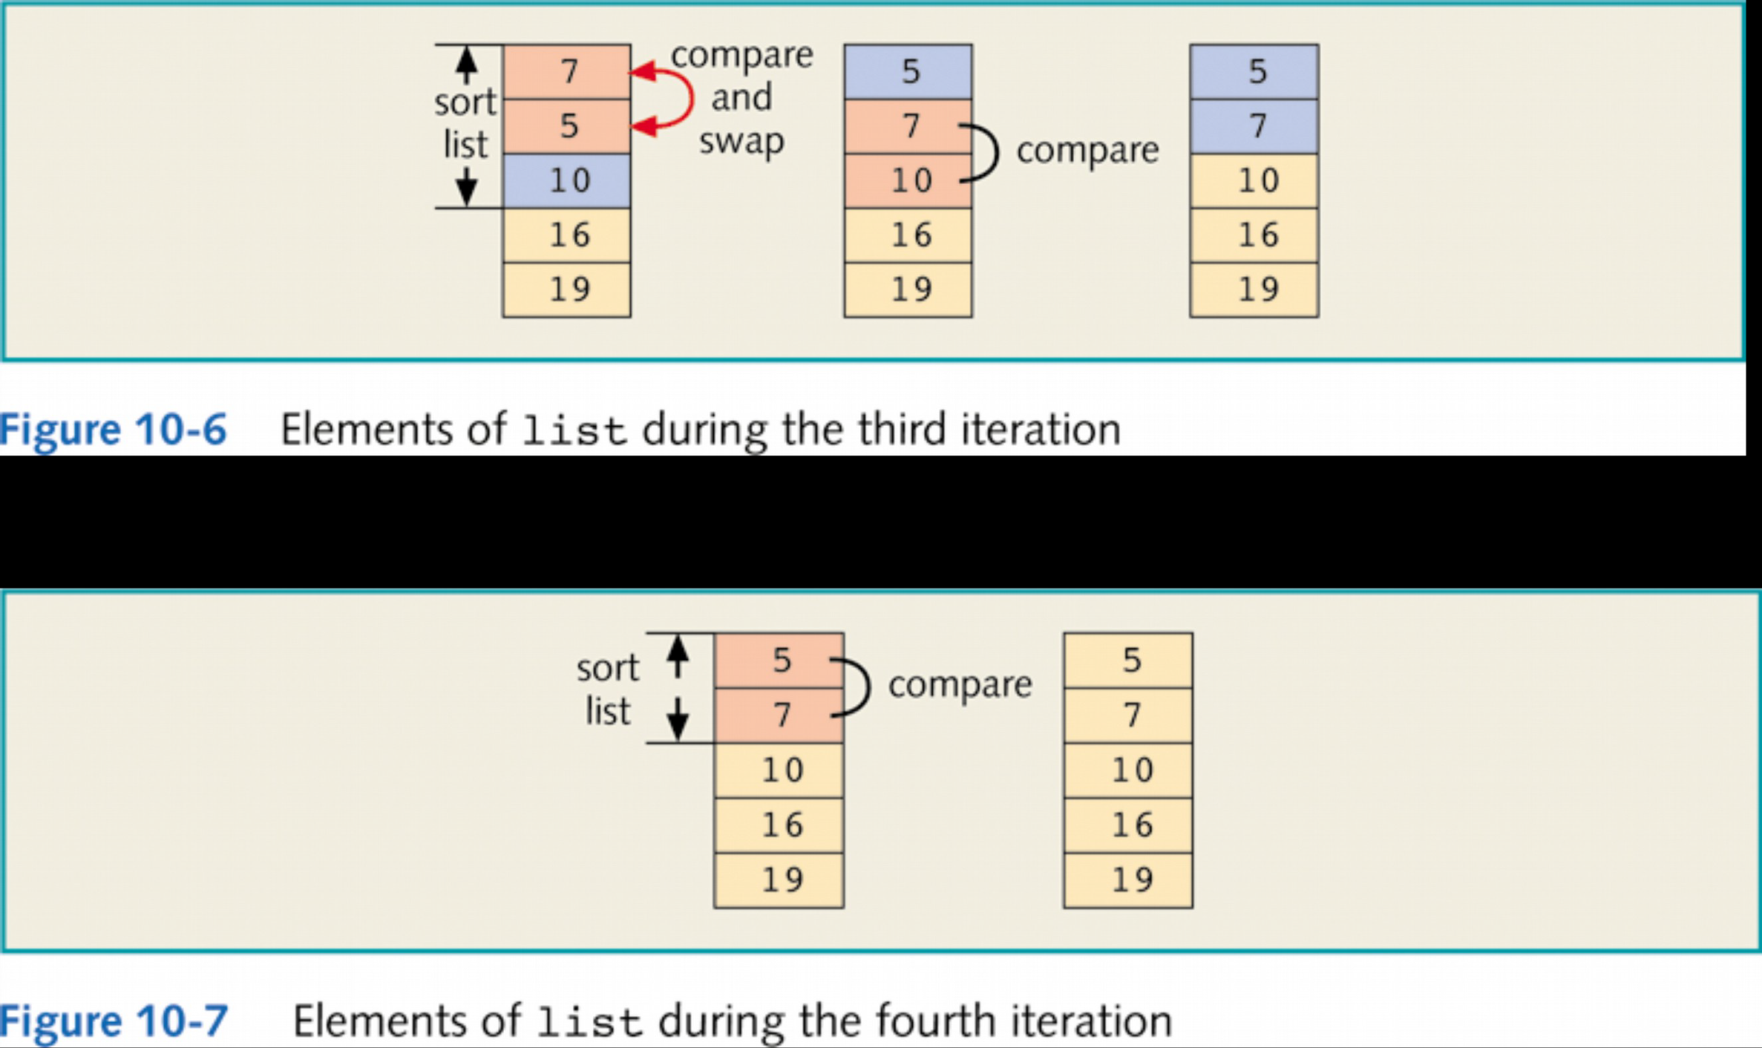
Bubble Sort: Example(cont’d)

Slide 5
Bubble Sort: Analysis
Worst case: If list is sorted in descending order, then
Number of comparison: 1+2+3+…+n-1=n(n-1)/2
Number of swaps: 1+2+3+…+n-1=n(n-1)/2
Time complexity= O(n²)
Best Case: If list is sorted in ascending order, then
Number of comparison: 1+2+3+…+n-1 = n(n-1)/2
Number of swaps: 0(no swaps) required
Time complexity=O(n²)

Slide 6
Insertion Sort
Single element is considered to be sorted
Add one more element in each iteration and insert in existing sorted list. Make space for newly picked element by moving elements towards right.
insertionSort(int a[], int n) {
for(int i=1; i<n; i++)
for(int j=i; j>0; j--) {
if(a[j-1] >a[j])
swap(a[j-1], a[j]);
}
}

Slide 7
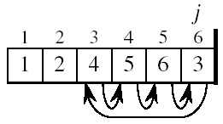
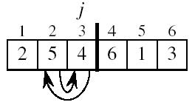
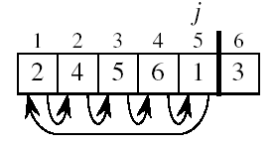
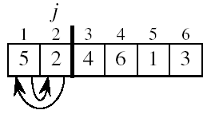
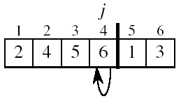
Insertion Sort: Example

Slide 8


Insertion Sort: Analysis
Worst Case: If list is sorted in descending order
Number of comparison: 1+2+3+…+n-1 = n(n-1)/2
Number of swaps: 1+2+3+…+n-1= n(n-1)/2
Time complexity= O(n²)
Best Case: If list is sorted in ascending order
Number of comparison: 1+1+1+…+1(n-1 times) = n-1
Number of swaps: 0(no swaps)
Time complexity= O(n)

Slide 9
Selection Sort
Sort list of n elements by selecting element for each position, starting from first position
In each iteration, list of unsorted elements shrink from front
selectionSort(int a[], int n) {
for(int i=0;i<n-1;i++) {
index=i;
for(int j=i+1; j<n; j++)
if(a[index]>a[j])
index=j;
swap(a[i],a[index]);
}
}

Slide 10
Selection sort: Example
5 | 2 | 4 | 6 | 1 | 3
1st iteration, swap(a[0],a[4])
1 | 2 | 4 | 6 | 5 | 3
2nd iteration, swap(a[1],a[1])
1 | 2 | 4 | 6 | 5 | 3
3rd iteration, swap(a[2],a[5])
1 | 2 | 3 | 6 | 5 | 4
4th iteration, swap(a[3],a[5])
1 | 2 | 3 | 4 | 5 | 6
5th iteration, swap(a[4],a[4])
1 | 2 | 3 | 4 | 5 | 6

Slide 11
Selection Sort: Analysis
Worst case:
Number of comparison: n-1+n-2+…+2+1 = n(n-1)/2
Number of swaps: 1+1+1+…+1(n-1 times)= n
Time complexity = O(n²)
Best Case:
Number of comparison: n-1+n-2+…+2+1 = n(n-1)/2
Number of swaps: 1+1+1+…+1(n-1 times)= n
Time complexity = O(n²)

Slide 12
Heap Sort
Build heap using BuildHeap method for array elements
In each iteration, delete minimum element from top and store at last position of heap(so far unsorted array)
In every iteration, one more element get added to sorted half of the array
Finally we will get array sorted in descending order
To sort array in ascending order, use max-heap

Slide 13
Heap Sort: Algo
heapSort(int a[], int n) {
BuildHeap(a, n);
for(i=n; i>1; i--) {
a[i-1] = deleteMin(a,i);
}
}
Time Complexity:
BuildHeap has time complexity: O(n)
Deleting root element from heap and heapifying: O(log n)
Deleting n elements therefore will take: O(n log n)
Total time required: O(n log n)

Slide 14
Heap Sort: Example
5 | 2 | 4 | 6 | 1 | 3
BuildHeap
1 | 2 | 3 | 6 | 5 | 4
Delete minimum and move at a[5]
2 | 4 | 3 | 6 | 5 | 1
Delete minimum and move at a[4]
3 | 4 | 5 | 6 | 2 | 1
Delete minimum and move at a[3]
4 | 6 | 5 | 3 | 2 | 1
Delete minimum and move at a[2]
5 | 6 | 4 | 3 | 2 | 1
Delete minimum and move at a[1]
6 | 5 | 4 | 3 | 2 | 1

Slide 15
Merge Sort
Divide array into two halves, recursively sort left and right halves, then merge two halves
Keep dividing until only one element remains

Slide 16
Merge sort: Example
Divide it in two at the midpoint
Conquer each side in turn (by recursively sorting)
Merge two halves together
8
2
9
4
5
3
1
6

Slide 17
Merge Sort: Example(cont’d)
8
2
9
4
5
3
1
6
Divide
8 2 9 4
5 3 1 6
Divide
8 2
9 4
5 3
1 6
Divide
1 element
8 2 9 4 5 3 1 6
Merge
2 8 4 9 3 5 1 6
Merge
2 4 8 9 1 3 5 6
Merge
1 2 3 4 5 6 8 9

Slide 18
Merge Sort: Algo
mergeSort(Arr, start, end) {
if(i == j) return;
else {
mid= (start+end)/2;
mergeSort(Arr, start, mid);
mergeSort(Arr, mid+1, end);
merge(Arr, start, mid, end); // merge two sorted half
}
}

Slide 19
Merge Algo: Analysis
Merging sorted array of total length n will take: O(n)
Recurrence relation for time complexity of mergeSort:
T(n)=2T(n/2) + n
Solving this will give: T(n)=O(n log n)

Slide 20
Quick Sort
Using a pivot element, divide list in two halves which are a[i] < pivot and a[i] > pivot
In each iteration, we find right position for pivot element picked.
Run quick sort for two halves recursively
Pivot elements can be picked based on multiple techniques
Basic technique is to pick first element

Slide 21
Quick Sort: Example
S
select pivot value
81
43
31
57
13
75
92
0
65
26
S₁
S₂
partition S
0
31
75
13
43
65
92
81
26
57
S₁
S₂
QuickSort(S₁) and
QuickSort(S₂)
0
13
26
31
43
57
65
75
81
92
S
0
13
26
31
43
57
65
75
81
92
S is sorted

Slide 22
Quick Sort: Best case
Ideally, Pivot element should divide list in two parts
Hence recurrence relation:
T(n) = 2T(n/2) + n
Solving this would give: T(n)=O(n log n)

Slide 23
Quick sort: worst case
If array is already sorted, pivot will divide array into two halves with 0 and n-1 elements
Recurrence relation in worst case therefore would be:
T(n) = T(n-1) + n
Solving this gives: T(n) = O(n²)

Slide 24
Comparison-based Sorting
Several sorting algorithms have been discussed and the best ones, so far:
Heap sort and Merge sort: O( n log n )
Quick sort (best one in practice): O( n log n ) on average, O( n² ) worst case
Can we do better than O( n log n )?
No.
It is be proven that any comparison-based sorting algorithm will need to carry out at least O( n log n ) operations

Slide 25
Non-comparison based Sorting
Suppose the values in the list to be sorted can repeat but the values have a limit (e.g., values are digits from 0 to 9)
Sorting, in this case, appears easier
Is it possible to come up with an algorithm better than O( n log n )?
Yes
Strategy will not involve comparisons

Slide 26
Counting Sort
Idea: suppose the values are in the range 0..m-1; start with m empty buckets numbered 0 to m-1, scan the list and increase the count of elements in the bucket
Will need an array of buckets, and the values in the list to be sorted will be the indexes to the buckets
No comparisons will be necessary

Slide 27
Counting Sort: Example
4 | 2 | 1 | 2 | 0 | 3 | 2 | 1 | 4 | 0 | 2 | 3 | 0
0 00
1 1
2 2 22
3 3
4 4
0 | 0 | 0 | 1 | 1 | 2 | 2 | 2 | 2 | 3 | 3 | 4 | 4

Slide 28
Counting Sort: Algo
CountingSort(S) { //(values in S are between 0 and m-1 )
for(j=0; j<m; j++) // initialize m buckets
b[j] = 0;
for(i=0; i<n; i++) // place elements in their
b[S[i]] = b[S[i]] + 1; // appropriate buckets
i=0;
for(j=0; j<m; j++) { // place elements in buckets
for(r=1; r<=b[j]+1; r++) { // back in S
S[i] =j;
i=i + 1;
}
}
}

Slide 29
Counting Sort: Analysis
Bucket initialization: O( m )
From array to buckets: O( n )
From buckets to array: O( n )
Since m will likely be small compared to n, Bucket sort is O( n )
Strictly speaking, time complexity is O ( n + m )

Slide 30
Sorting integers
Can we perform counting sort on any array of (non-negative) integers?
Yes, but note that the number of buckets will depend on the maximum integer value
If you are sorting 1000 integers and the maximum value is 999999, you will need 1 million buckets!
Time complexity is not really O( n ) because m is much > than n. Actual time complexity is O( m )
Can we do better?

Slide 31
Bucket Sort
Idea: Divide n elements into M buckets. Sort each bucket independently using insertion sort. Finally sequentially access all the elements from buckets starting from first bucket. Resultant array is sorted array.
Array to be sorted can have any non-negative integers and should be uniformly distributed i.e. should not be the case that all elements go into one bucket.

Slide 32
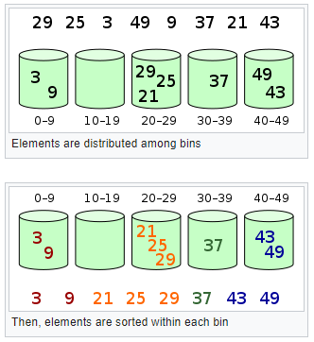
Bucket Sort: Example

Slide 33
Radix Sort
Idea: repeatedly sort by digit—perform multiple bucket sorts on S starting with the rightmost digit
If maximum value is 999999, only ten buckets (not 1 million) will be necessary
Use this strategy when the keys are integers, and there is a reasonable limit on their values
Number of passes (bucket sort stages) will depend on the number of digits in the maximum value

Slide 34
Radix Sort: Example (1st Pass)
12 | 58 | 37 | 64 | 52 | 36 | 99 | 63 | 18 | 9 | 20 | 88 | 47
20
12 52
63
64
36
37 47
58 1888
9 99
20 | 12 | 52 | 63 | 64 | 36 | 37 | 47 | 58 | 18 | 88 | 9 | 99

Slide 35
Radix Sort: Example(2nd Pass)
20 | 12 | 52 | 63 | 64 | 36 | 37 | 47 | 58 | 18 | 88 | 9 | 99
9
12 18
20
3637
47
52 58
63 64
88
99
9 | 12 | 18 | 20 | 36 | 37 | 47 | 52 | 58 | 63 | 64 | 88 | 99

Slide 36
Radix Sort: Example (Both Passes)
12 | 58 | 37 | 64 | 52 | 36 | 99 | 63 | 18 | 9 | 20 | 88 | 47
sort by rightmost digit
20 | 12 | 52 | 63 | 64 | 36 | 37 | 47 | 58 | 18 | 88 | 9 | 99
sort by leftmost digit
9 | 12 | 18 | 20 | 36 | 37 | 47 | 52 | 58 | 63 | 64 | 88 | 99

Slide 37
Radix Sort: Analysis
If there is a fixed number p of bucket sort stages (six stages in the case where the maximum value is 999999), then radix sort is O( n )
There are p bucket sort stages, each taking O( n ) time
Strictly speaking, time complexity is O(pn), where p is the number of digits (note that p = log₁₀m, where m is the maximum value in the list)

Slide 38
Radix Sort: For Words
Note that only 10 buckets are needed regardless of number of stages since the buckets are reused at each stage
Radix sort can apply to words
Set a limit to the number of letters in a word
Use 27 buckets (or more, depending on the letters/characters allowed), one for each letter plus a “blank” character
The word-length limit is exactly the number of bucket sort stages needed

